Slide 1
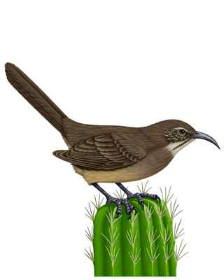
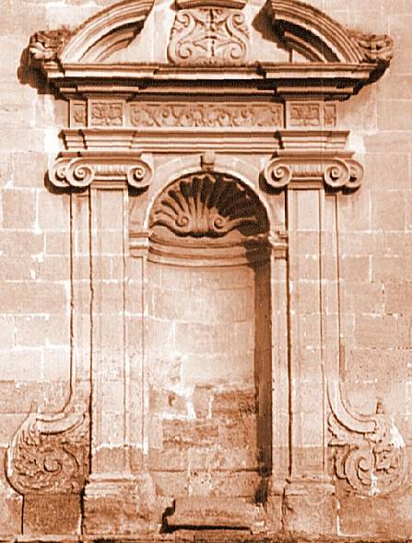
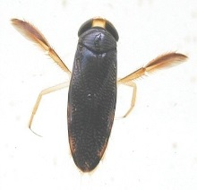
Metacommunities:

Slide 2
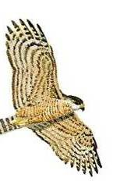
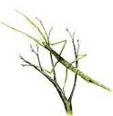
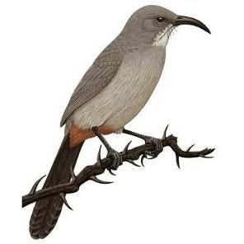

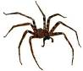
A Brief History of the (Ecological) Niche Concept
Niche
Factor Y
Factor Z
Factor X
Grinnell (1917)→Hutchinson (1957)

Slide 3
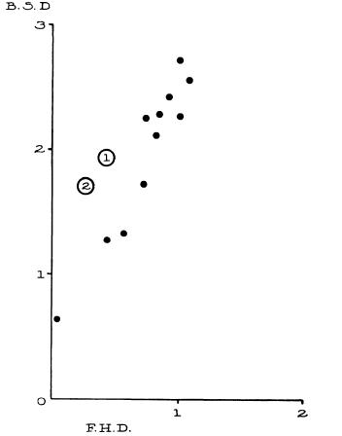
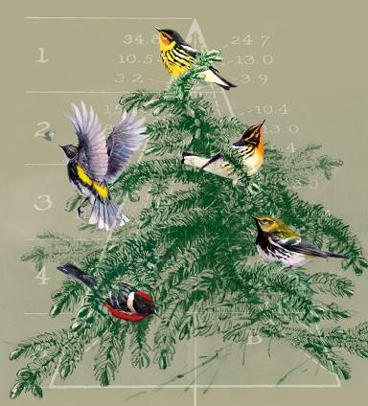
Ecological Niches as the Basis for Coexistence/Diversity
Bird Diversity
Limiting Similarity (Hutchinsonian ratios)
--Hutchinson 1959
Competition and coexistence
--MacArthur (1958)
Foliage Height Diversity
MacArthur and MacArthur 1961

Slide 4
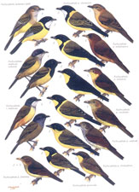
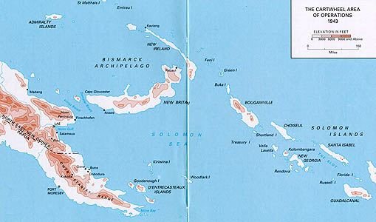
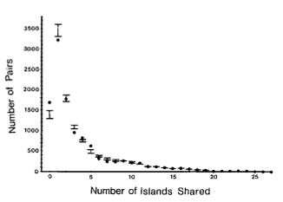
Diamond’s ‘Assembly Rules’

Slide 5
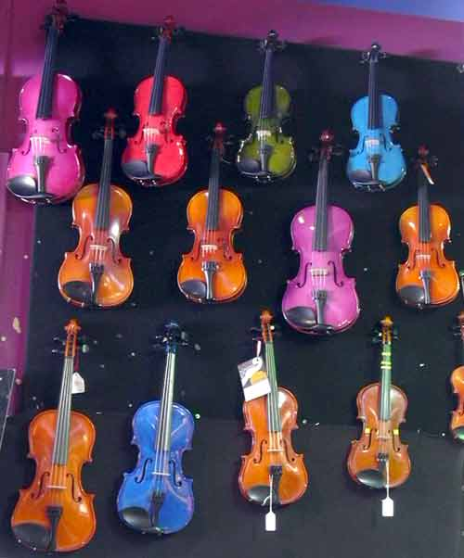
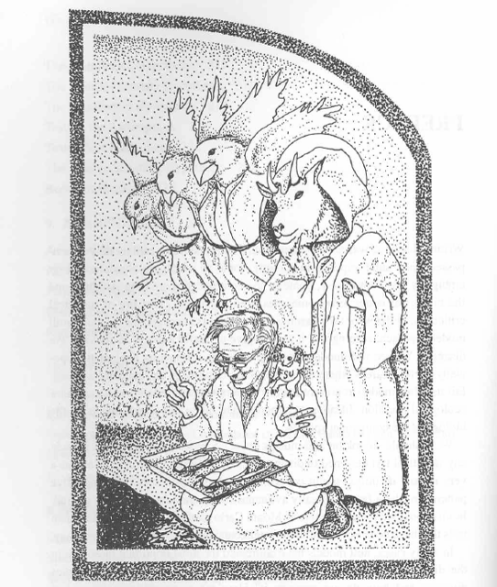
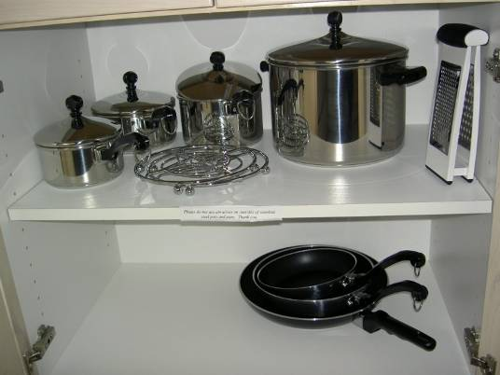
-D. Simberloff
Drawing by S. Naeem

Slide 6
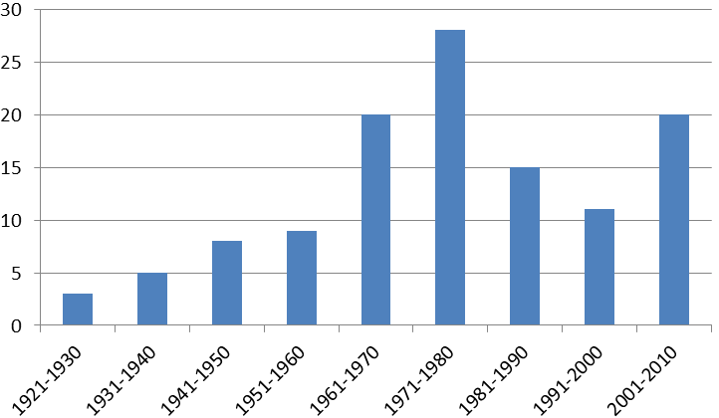
‘Ecological Niche’ concept through time
Hutchinson
MacArthur
Percentage of papers
Grinnell
Elton
Percentage of papers in Ecology using ‘niche’

Slide 7
‘Ecological Niche’ concept through time
Simberloff, Strong et al.
??
Hutchinson
MacArthur
Percentage of papers
Grinnell
Elton
Percentage of papers in Ecology using ‘niche’

Slide 8
Back to Square 1:
Present→B>D
Absent→B<D
(in a closed population)
N_{t}=Population in the current time step
N_{t+1}=Population in the next time step (t +1)
B=# Births
I=# of Immigrants
D=# Deaths
E=# Emigrants

Slide 9
Two species together…the species with the lowest R* always wins
….when there is only one limiting resource, and the system is at equilibrium
b₁
b₂
Per Capita growth
or loss rate
d₂
R₁*
R₂*
Resource Availability (R)
…A fundamental principle…the R* Rule
…But, then how do species coexist??

Slide 10
Fundamental Principle of Coexistence: Linked trade-offs
Resource Competition
Apparent Competition
Coexist
Resource A
Predator A
Coexist
Resource B
Predator B
Keystone Predation
Disturbance/variation
Predator
Disturbance/ E nv. variation
Coexist
Coexist
Resource
Resource
Chase and Leibold 2003

Slide 11
Species can’t be too similar……
….but, they also can’t be too different
~Chesson’s (2000) General Theory of Coexistence
Coexistence depends on the ratios of:
→Stabilizing Mechanisms (Can’t be too similar)
→Equalizing Mechanisms (Can’t be too different)
Possible Coexistence
Possible Coexistence
Resource A
Resource B

Slide 12
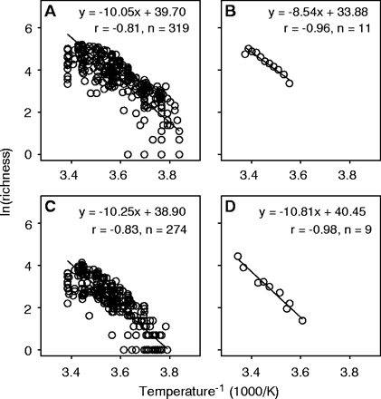
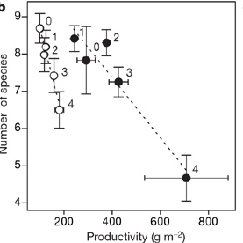
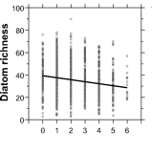
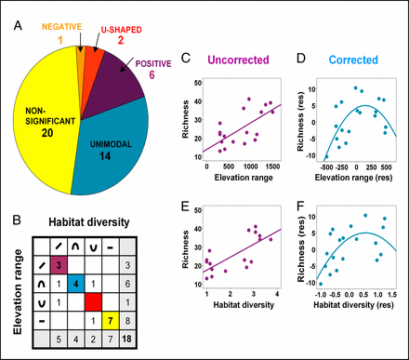
Niches still at the forefront of biodiversity studies…..
Allen et al. 2002 Science
Harpole and Tilman 2007 Nature
Passey 2008 PNAS
Allouche et al. 2012 PNAS

Slide 13
Even classic coexistence stories had a spatial component
Gause 1934

Slide 14
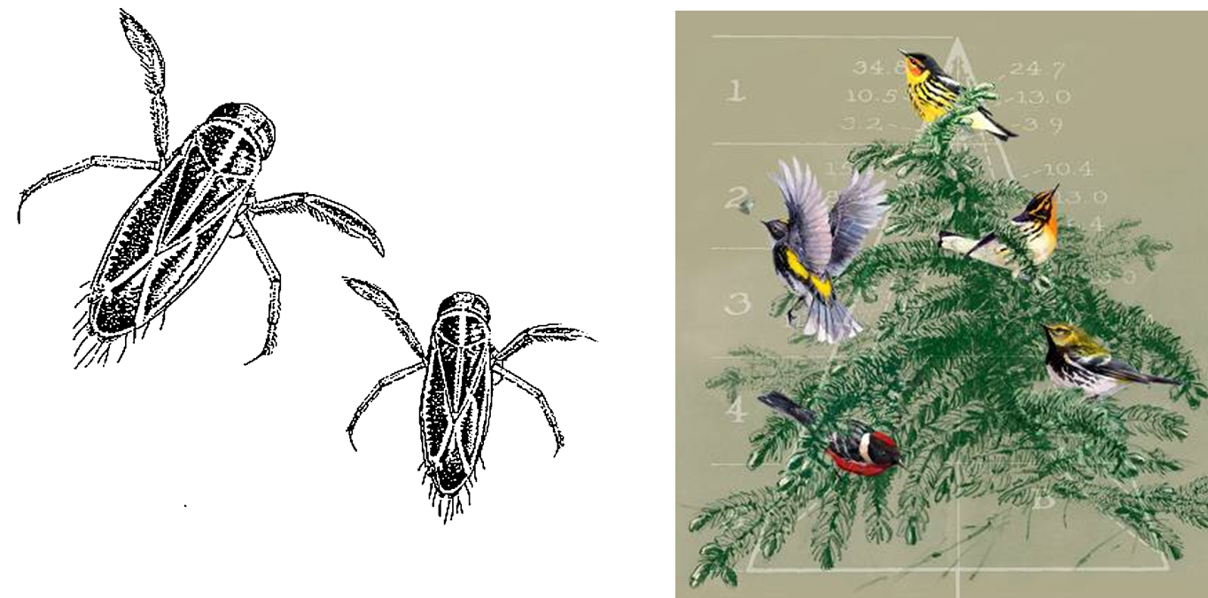
Even classic coexistence stories had a spatial component

Slide 15

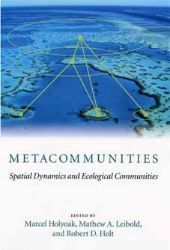
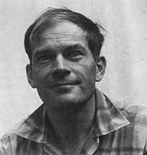
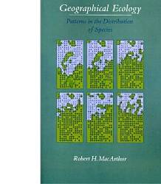
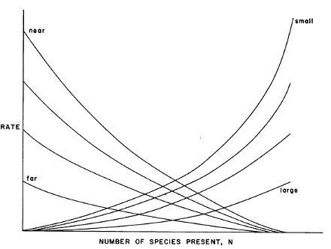
“MacArthur’s Paradox” and the Metacommunity
Local perspective
Regional perspective
Original Resource Ratio Model
Basis for Niche Theory
Theory of Island Biogeography:
Basis for Neutral Theory

Slide 16
MacArthur’s Paradox: The Role of Space

Slide 17
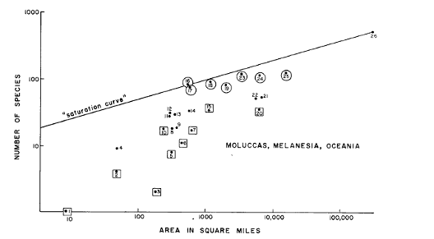
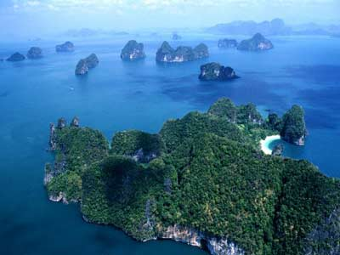
The role of space…
MacArthur and Wilson 1963

Slide 18
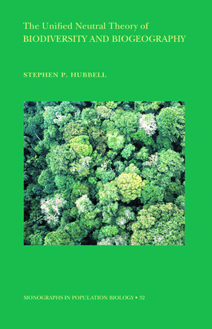
Unified Neutral Theory:
A successful, if not simplistic, metacommunity theory
Are species everywhere they could be?
What regulates species commonness and rarity?
Are communities stable or ever-changing through time?
The ‘Neutral Theory’ provided an alternative framework to more traditional ‘Niche Theory’ that appeared to predict a number of commonly observed patterns in nature

Slide 19
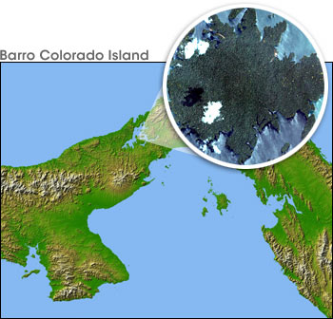
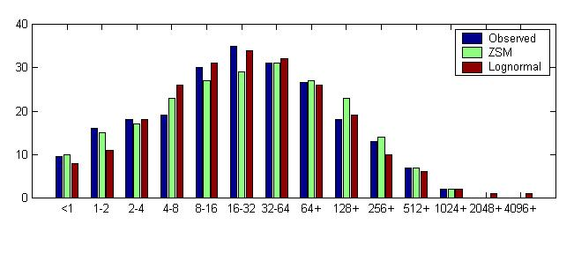
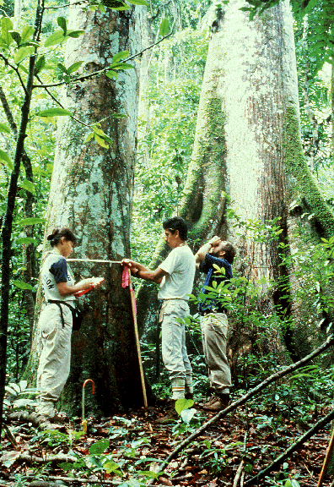
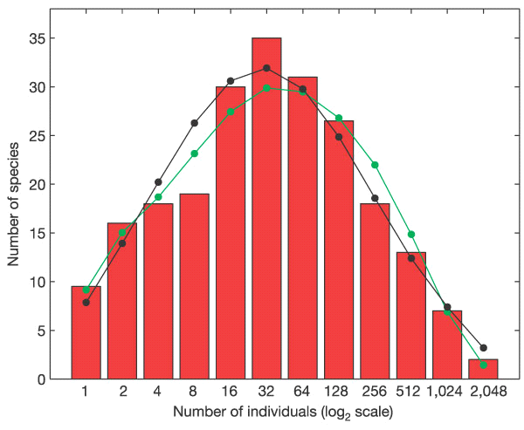
Tests with Species Abundance Distributions (SADs)
Initial tests of neutral theory
50 ha on Barro Colorado Island
McGill 2003, Nature
ZSM
Lognormal
Volkov et al. 2004, Nature

Slide 20
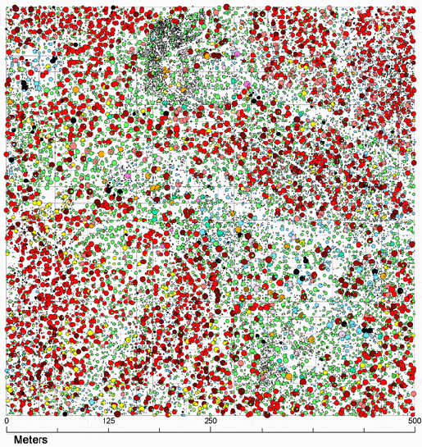
What influences spatial aggregation? How do we quantify it?

Slide 21
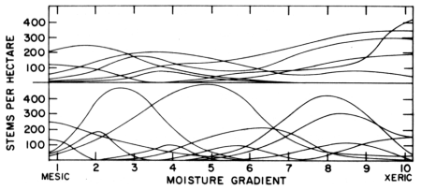
Whittaker’s concept of β-diversity
Low β-diversity
Siskiyou Mountains, Oregon
Santa Catalina Mountains, Arizona
High β-diversity
A deterministic “niche-based” perspective

Slide 22
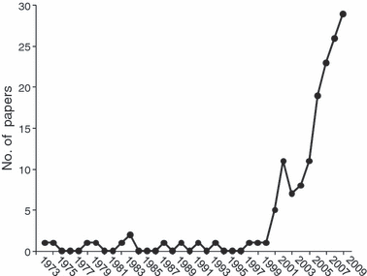
The β-diversity concept through time
Anderson, et al. 2011 Ecology Letters

Slide 23
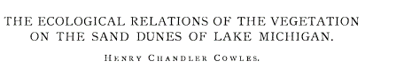
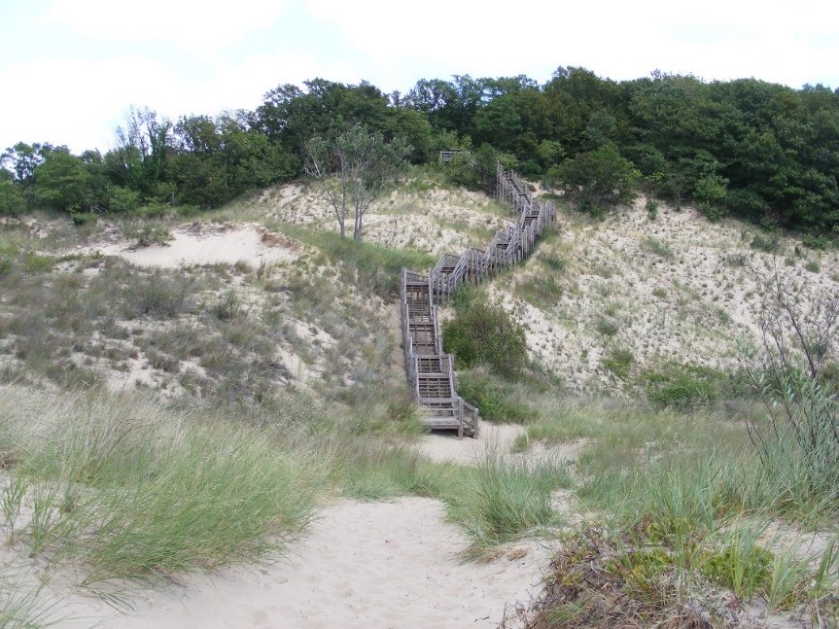
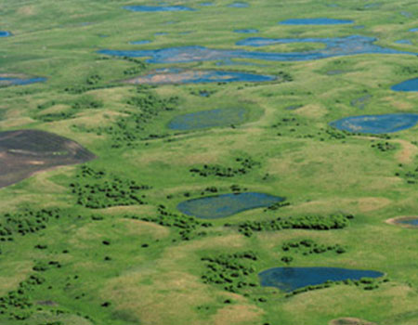

Just How Predictable are Communities?
… Tansley, Gleason, Cooper, Egler, others
"The vegetation of an area is merely the resultant of …the fluctuating and fortuitous immigration of plants and an equally fluctuating and variable environment”
…Clements, Phillips, others
Climax communities and super-organisms
Gleason 1926

Slide 24
Using β-diversity to Disentangle Niche vs. Drift/Dispersal Limitation
Regional Species
Pool
β-
diversity
Species Sorting
(Niche)
A B C D
A B C D E
F G H I J
D E F G
G H I J
Regional Species
Pool
β-
diversity
A B C D
A B C D E
F G H I J
Stochastic assembly
(Drift)
D E F G
G H I J

Slide 25
Space vs. environment: What can β-diversity tell us?
Neutral Model
Niche Model
Beta-diversity
Beta-diversity
Spatial gradient
Spatial gradient
Environmental gradient
Environmental gradient
Chase et al. 2005

Slide 26
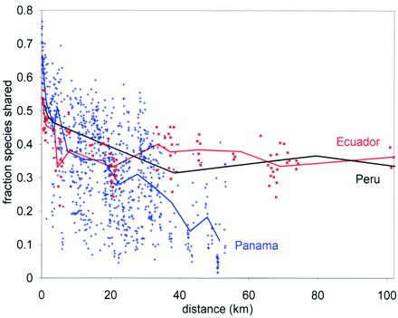
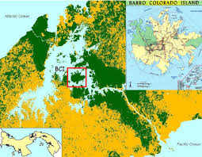
Beta diversity in tropical forests: Lots of ‘unpredictability’ (i.e., drift)
Condit et al. 2001 Science

Slide 27
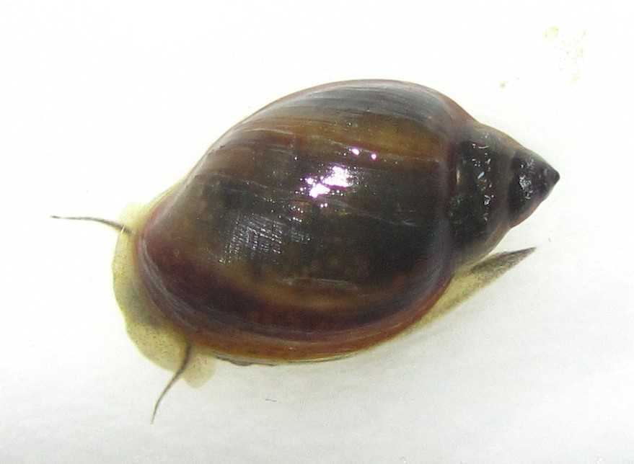
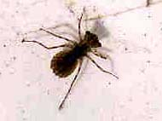
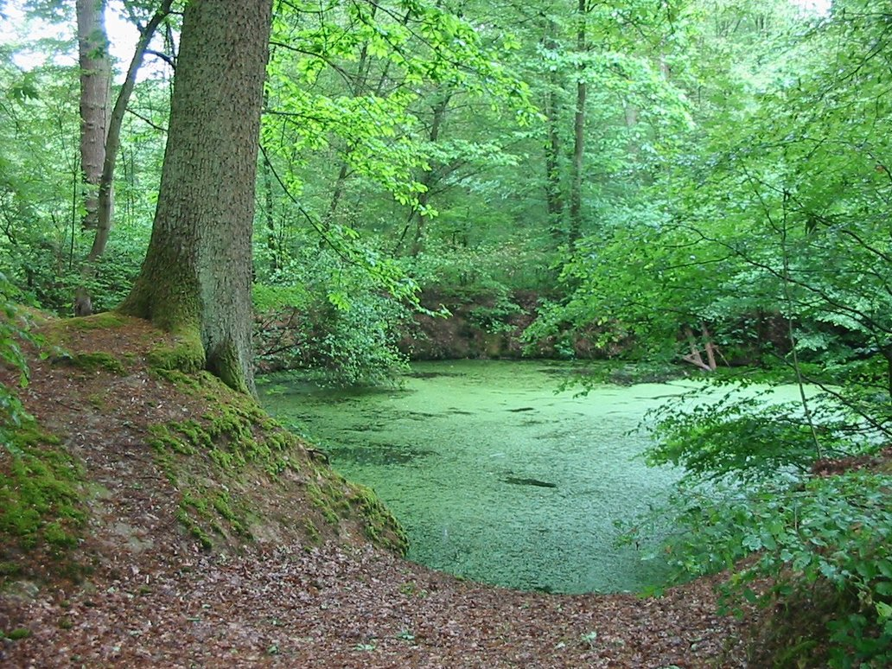
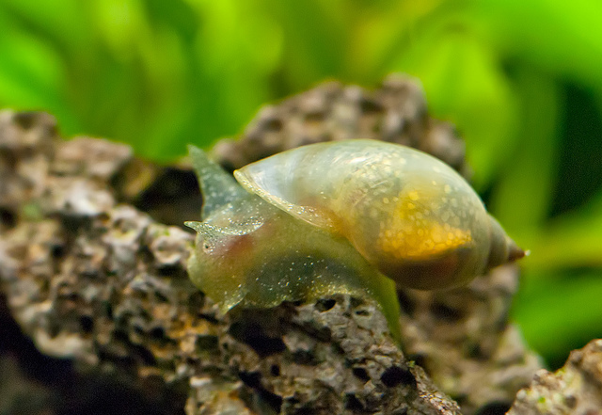
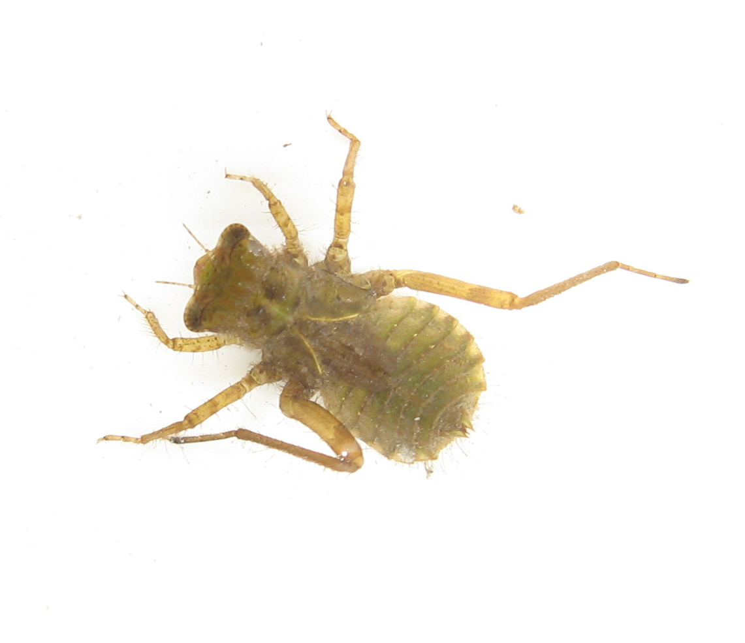
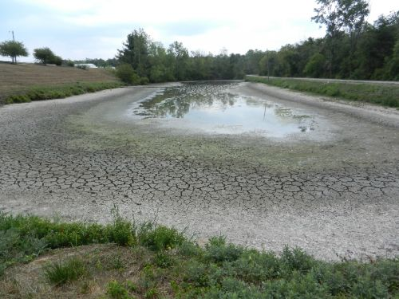
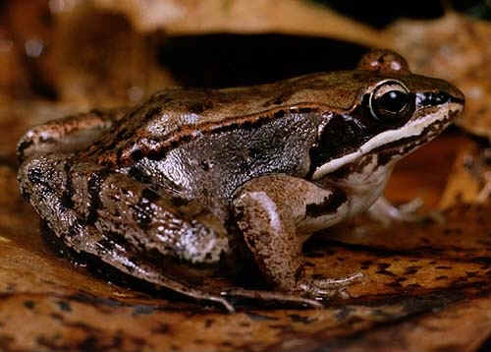
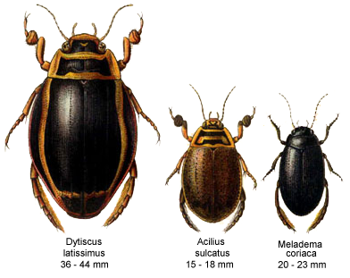
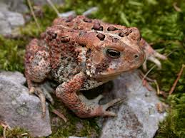
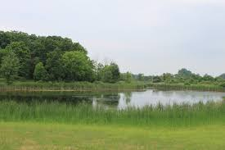








Small Freshwater Ponds—Niche Reigns Supreme
1
0.75
0.5
0.25
0
1
0.75
0.5
0.25
0
Compositional Similarity (Jaccard’s)
Compositional Similarity (Jaccard’s)
0 50 100 150 200 250 300 350 400 450
0 0.1 0.2 0.3 0.4 0.5 0.6 0.7 0.8 0.9 1.0
Spatial Distance (m)
Environmental Distance

Slide 28


Partitioning the variation of β-diversity
(Legendre, Borcard, Peres-Neto, et al).
β-diversity structure
Spatial/Environmental structure

Slide 29

Patterns on BCI and Ponds are at the extremes
Ponds
BCI

Slide 30
Even in Tropical Forests BCI is Unusual
BCI
Baldeck et al. 2013 Proc. Roy Soc.

Slide 31

A lot of unexplained variation—drift (?), unmeasured?
‘Unexplained variation’
Leibold and Chase 2017

Slide 32
When/Where is Ecological Drift More Likely to be Important?
Smaller population sizes/habitats.
2. Larger species pools
3. More benign environmental conditions…
….Less ‘Niche Selection’
4. Less heterogeneity
5. Lower rates of dispersal

Slide 33




Is Neutral Theory More Prevalent in the Tropics??

Slide 34




Using the null model to infer process
Gentry’s O.1 ha forest transects
Species are more ‘aggregated’ than expected, and this appears to be similar across biogeographic regions
Kraft, Comita, Chase et al. 2011 Science

Slide 35
Is the null model enough to fix the sample biases?
Unfortunately…. No
Small plot➔
Lower Heterogeneity
Large plot➔Higher Heterogeneity
Environment
Residuals, Space
Environment
Residuals, Space

Slide 36


Patterns on BCI and Small Ponds are at the extremes
….But are they structured by different processes??
Somewhere in the middle
(Synthesis v.1)
Environment (≈ niche)
BCI
Space (≈ dispersal)
Michigan Ponds
Residuals (≈ drift + unmeasured)
Cottenie 2005, Ecol. Lett
Leibold & Chase 2017

Slide 37







Comparing ponds vs. BCI: Metacommunity Scale Mismatch
~10,000-500,000 individuals
~250,000 individuals
~10,000,000-500,000,000 individuals
~390,000,000 individuals
Fricker et al. 2012, Remote Sens, 4(6))

Slide 38
Habitat Associations are Stronger at Larger Scales on BCI
Tabebuia guayacan
Jacaranda copaia
Oenocarpus mapora
Attalea butyracea
Garzon-Lopez et al. 2014. J. Veg Sci

Slide 39
Scale→Community Assembly (Synthesis v. 2)
Environment
Dispersal
Environment (≈ niche)
Environment (≈ niche)
Fishless permanent ponds
Space (≈ dispersal)
Space (≈ dispersal)
BCI
All ponds
Permanent ponds
Residuals (≈ drift + unmeasured)
Residuals (≈ drift + unmeasured)
Viana and Chase 2019 Ecology
Viana and Chase 2019

